Slide 1
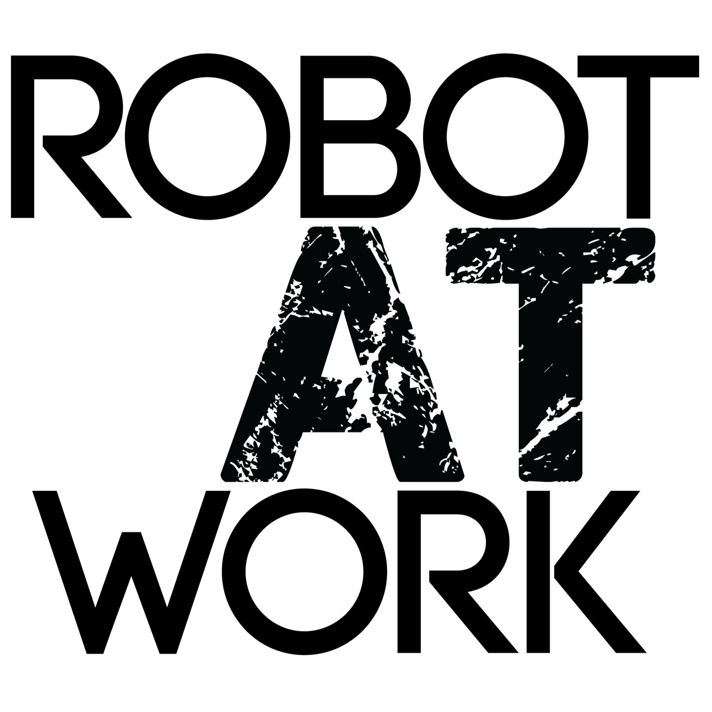
Develops a generic and unique guided user interface to manage various robot solutions within the construction industry

Slide 2
The Construction Industry
Construction industry
Potential not fulfilled
Potential not fulfilled
Industry 1.0 Mechanical production and processes
Industry 2.0 Mass production and industrialization
Industry 3.0 Automation – IT and electronics
Industry 4.0 Connectivity – big data, IoT, collaborative robotics

Slide 3
Robot At Work’s Software Platform
Customer problem or new robot solutions
Milling robot
Our postprocessor for robot script
Path generator from 3D design file
3D facade
Software flow
Input: .stl/ scan/ vision
Painting robot
Robot solution X
Robot solution Y
Tablet on-site Guided user interface
Robot solution Q

Slide 4
Business Model (R&D + Software License)
Joint Venture
R&D
Robot work onsite
“On site” at other customers with Robot at Work platform
R&D
$ R&D


JV Company “solution”
Robot At Work & Partner
Robot Solution
“On site” at partner with Robot at Work software platform
Software license pr. m²
Software support & service

Slide 5
About Robot at Work
Robot at Work Is highly specialized in energy renovation of facades and gables by using robots. Based on a generic software platform enabling standard robots to work on building sites, we have developed a platform able to solve various customer problems. We are current supplying 2. solutions; robots milling between bricks and 3D facade robots – and looking for more joint venture solutions.
Funded in 2015 We have since then pre-tested the solution and software platform in collaboration with Rockwool, Technological Institute, the Architectural firm Area and AAU.
It is our goal to get the robots on the site as "co-workers".
Founders Anders Martiny: 20 years of experience within a wide range of advanced robot solutions for industry. Software, technical development, and commercial experience from other robot companies such as Kilde Automation A/S, Gibotech A/S
Finn Christensen: 15 years of experience within construction including developing new products and systems for energy and process optimization. For the last three years, Finn has worked with the development of new facade renovation solutions for energy optimization of existing buildings at a high international level.


Slide 6
Develops a generic and unique software platform to manage various robot solutions within the construction industry

